Slide 1


ANON
Zeroth Review

Slide 2

Project Guide
Dr. Nageswara Guptha M
Senior Associate Professor

Slide 3
Team Members
SHIKHAR VASHISHTHA – 19BCE10025
PRANTIK BHATTACHARJEE – 19BCE10222
PRASHANT CHAUHAN – 19BCE10280
VARDAAN VISHNU (c) – 19BCE10063

Slide 4
Introduction
Anon aims to be one of a kind app that will facilitate WhatsApp Messaging and WhatsApp Calling without having to save the recipients contact info
This idea originates from people’s need for quick messaging to unknown contacts, on the go!

Slide 5
Proposed work
Our Idea is to use an API (application programming interface) provided by Whatsapp public on it’s website.
Issues our APP aims to resolve are:
Women often encounter it uncomfortable in saving contact info of strangers for various reasons.Thus they can easily make use of ANON to contact such strangers whenever needed without worrying about their privacy.
Whatsapp the UPI payment feature to its commercial as well as business App in the near future. Thus if need arises, ANON can serve as a fit way of transfering money and paying bills to unknown people, that too right on the go!

Slide 6
Proposed work
The various features we wish to add to our app are:
Mass Messaging in Whatsapp, for spreading information faster among general public.
Temporarily saving contact info within app for later use.
Ability to backup chats with unknown contacts.

Slide 7
Novelty of the ANON
The Idea for this project arises from ‘having read the WhatsApp public API documentation’ which stated an API that could create chat links with a given Contact.
Novelty or Originality of concept remains the essence of this project
We will try to make our project as Original & Innovative as possible by constantly adding our own innovative ideas

Slide 8
Real Time Usage
Real time usage- How our app can be used in real time scenario-
1. We being students can send any assignment or tutorial related work to anyone without saving the number as our app is meant for these purposes only.
2. When WhatsApp will start digital transfer of money, then we can transfer money without saving the contact info, for faster transactions.

Slide 9
Overall System Architecture Design
Type the number whom you want to send the sms with country code.
1
Then we have options to send message through WhatsApp Web or Android app select accordingly.
2
We also have a option to send link for chat in the share option.
3
Whatsapp public API is used in application.
4
Material Design Lite Library is used in this app which lets us add a Material Design look and aims to optimize for cross-device use (Material Components for Android is available through Google's Maven Repository).
5

Slide 10
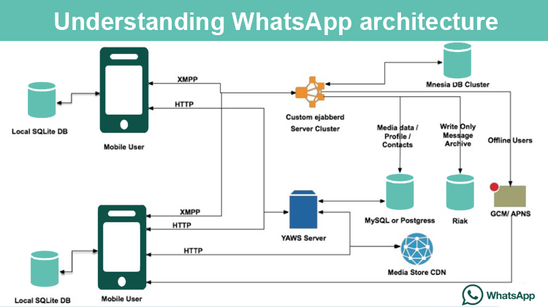

Slide 11
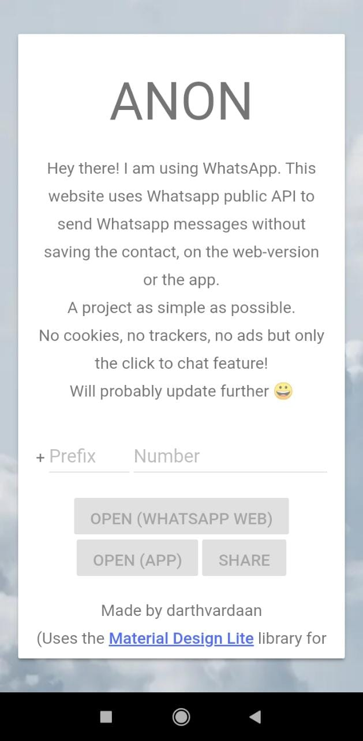
Progress Of Work

Slide 12
Summary Of Review
Anon uses WhatsApp public API (application programming interface) as provided on it’s website.
Issues Anon aims to resolve are :
Many people especially Women often encounter it uncomfortable in saving contact info of strangers for various reasons . Thus ANON can be used to contact such strangers whenever needed without worrying about privacy.
WhatsApp aims to have UPI payment feature to its commercial as well as business App in the near future. Thus if need arises, ANON can be used for transferring money and paying bills to unknown people on the go!

